Slide 1
HEAVY METAL MUSIC
Style 2

Slide 2
HEAVY METAL
Developed in the 1960s and 70s
Thick texture, using distorted guitars, amplification, extended guitar solos, emphatic beats and loudness.
Largely from UK and USA
Led Zeppelin, Black Sabbath and Deep Purple were pioneers of this genre
Influences include blues, rock, psychedelic and acid rock

Slide 3
Subgenres
Death Metal
Speed Metal
Originated in the mid-1980s and uses heavily distorted and low-tuned guitars, deep growling vocals; aggressive, powerful drumming; minor keys or atonality; abrupt tempo, key, and time signature changes; and chromatic chord progressions.
Originated in 1970s in Britain. Its characteristics include fast upbeat tempo, power chords, fast guitar solos and melodic expressive vocals.
Doom Metal
Black Metal
Originated in the 1970s and uses slower tempos, low-tuned guitars and a much "thicker" or "heavier" sound to envoke a feeling of doom.
Originated in 1980s and its traits include fast tempos, a shrieking vocal style, heavily distorted guitars, raw (lo-fi) recording, unconventional song structures, and an emphasis on atmosphere.

Slide 4
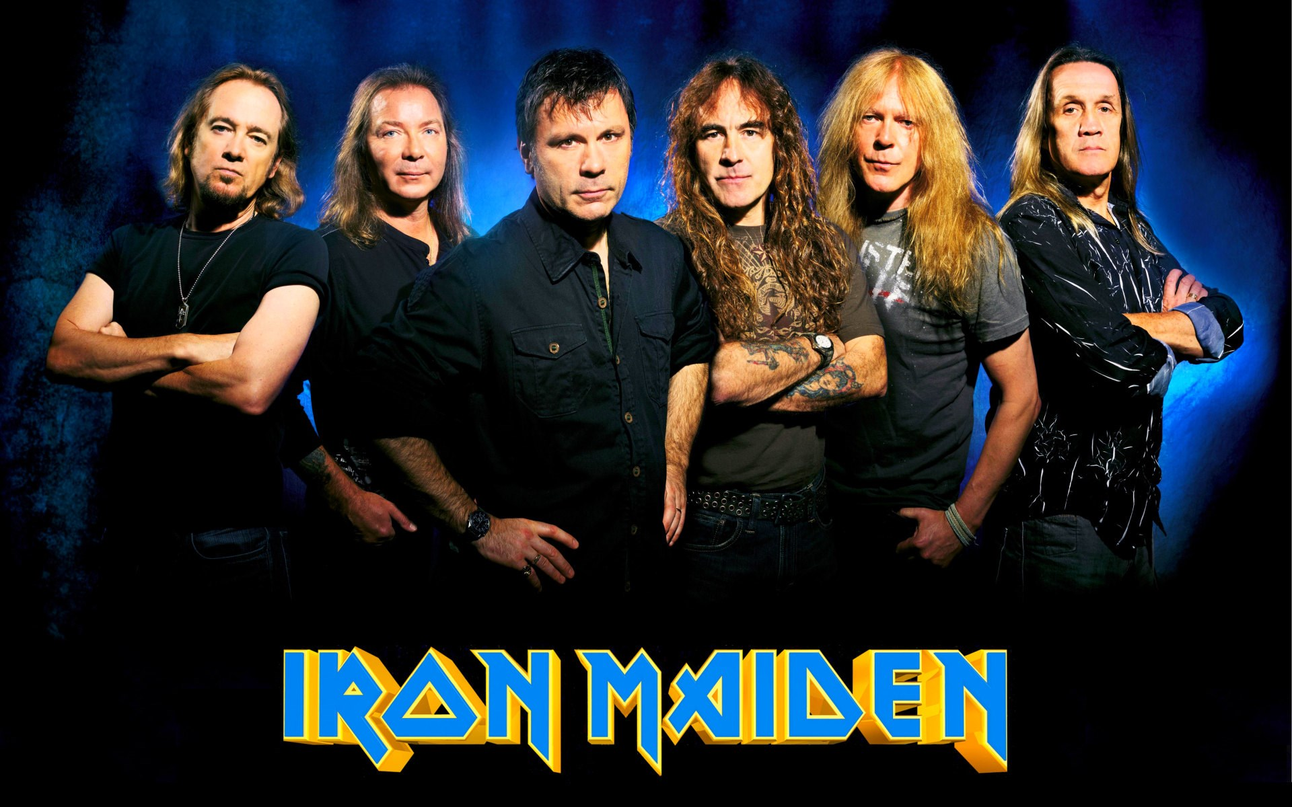
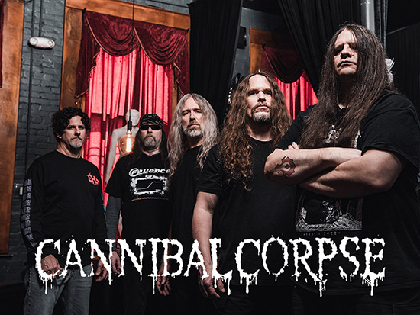
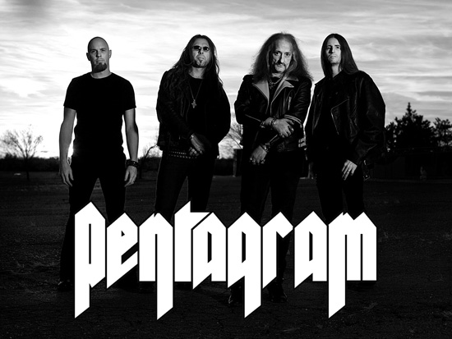
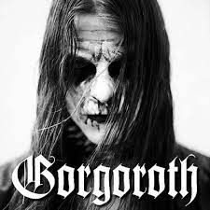
Subgenres
Speed Metal
Death Metal
Doom Metal
Black Metal

Slide 5
Subgenres
Subgenres may differ in terms
of instrumentation, tempo,
song structure, vocal style,
lyrics, guitar playing style,
drumming style, and so on.
Thrash Metal
Originated in the early 1980s and characterised by its aggression and fast tempo, low-register guitar riffs, overlaid with shredding-style lead guitar.
Alt Metal
Groove Metal
Originated in 1980s and characterised by heavily downtuned, mid-paced guitar riffs, a mixture of accessible melodic vocals and harsh vocals and sometimes unconventional sounds within other heavy metal styles.
Originated in the early 1990s and features raspy singing and screaming, down-tuned guitars, heavy guitar riffs, and syncopated rhythms.

Slide 6
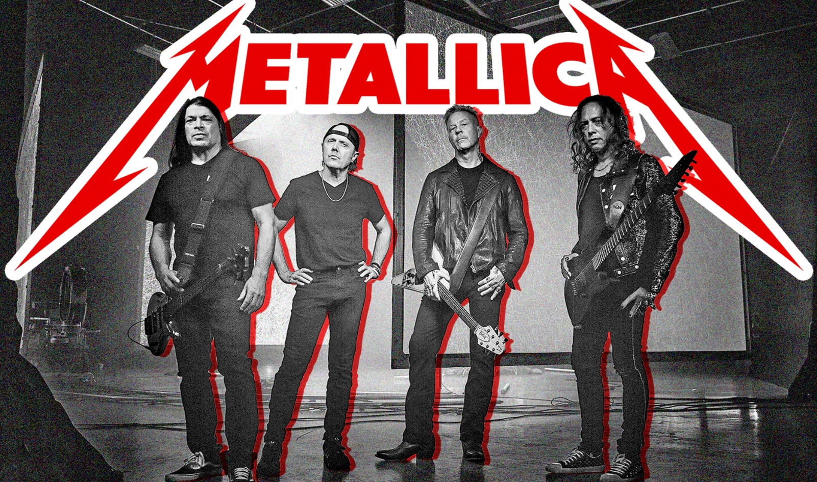
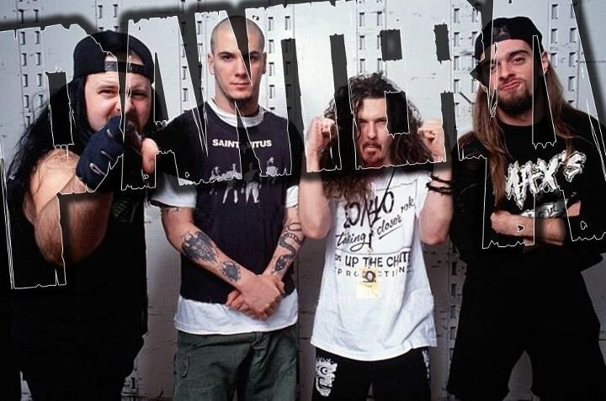
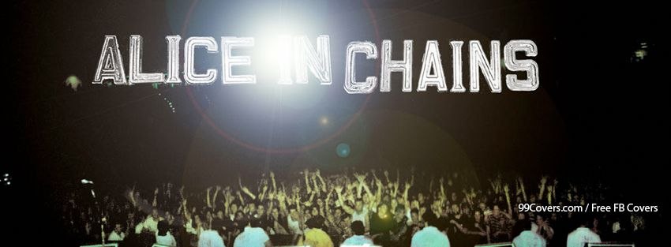
Subgenres
Thrash Metal
Subgenres may differ in terms
of instrumentation, tempo,
song structure, vocal style,
lyrics, guitar playing style,
drumming style, and so on.
Groove Metal
Alt Metal

Slide 7
INSTRUMENTS
The bands who play heavy metal music usually have one or two guitars, a bass guitar and drums.
In some bands, electronic keyboards, organs, or other instruments are used.

Slide 8
CHARACTERISTICS
Loud and powerful-sounding
Strong rhythms that are repeated
Power chords
Distortion pedal
Downtuned instruments
Unusual key changes
Unusual time signatures

Slide 9
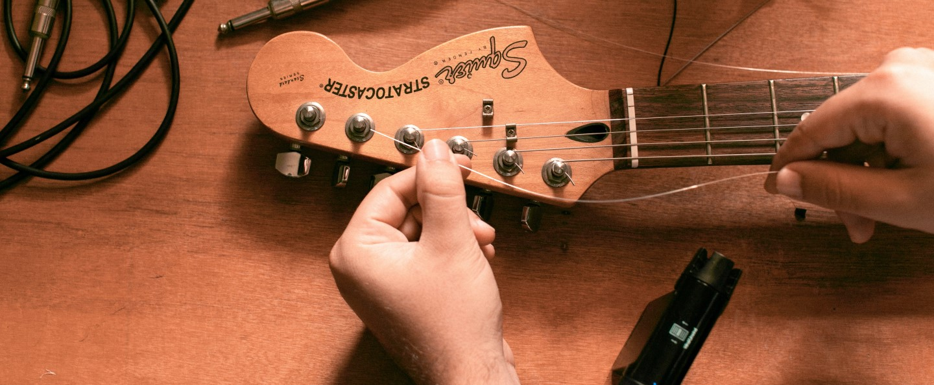
DOWNTUNED INSTRUMENTS
A musical instrument that has had its pitch deliberately lowered during tuning is said to be down-tuned or tuned down. One or more strings of the guitars are often tuned lower standard pitch.

Slide 10
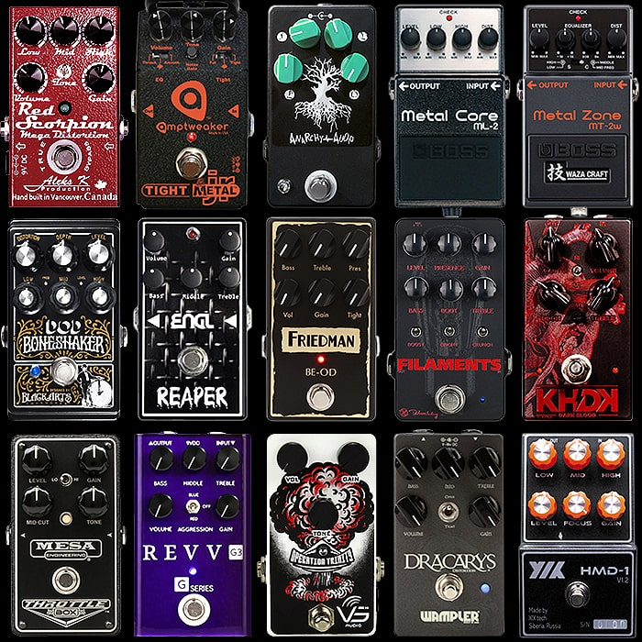
PEDALS
Distortion and overdrive are forms of audio signal processing used to alter the sound of amplified electric musical instruments, usually by increasing their gain, producing a "fuzzy", "growling", or "gritty" tone.

Slide 11
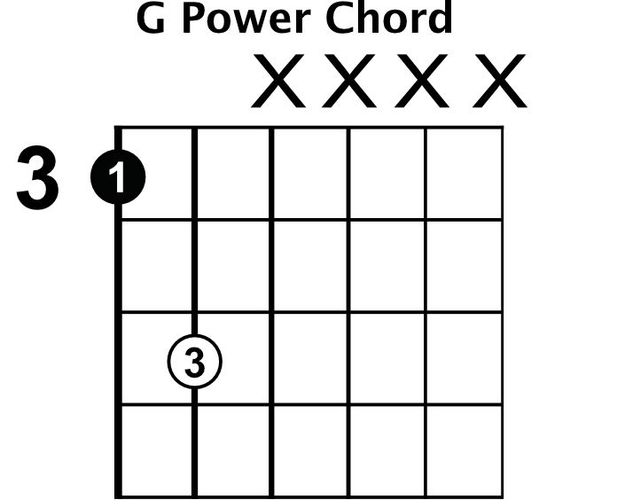
POWER CHORDS
A power chord is made of two different notes. The first (I) and fifth (V) note in a key.
For example: In C Major
Note 1 (I) is C
Note 5 (V) is G
Regarded as being popularized and named by Dave Mustaine of Megadeth, it is used to reduce string noise when playing (mostly chromatic) riffs that require chords across several strings.
Power chords have been used in some of the most epic guitar riffs of all-time and can be heard in songs like "Iron Man" (Black Sabbath).

Slide 12
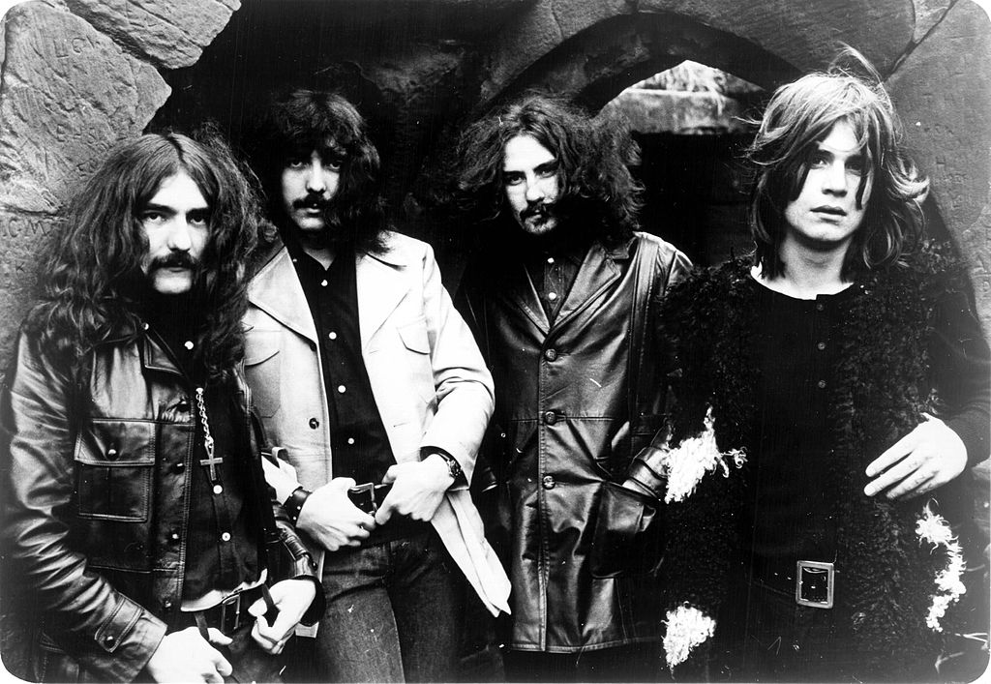
BLACK SABBATH
Many historians believe that this British band from Birmingham, invented Heavy Metal.
They released 19 albums between 1970 and 2013 and have sold over 70 million records worldwide.
They were influenced by Cream, The Beatles, Fleetwood Mac, Jimi Hendrix, John Mayall, Blue Cheer, Led Zeppelin, and Jethro Tull.
Ozzy Osbourne (vocals)
Tony Iommi (guitar)
Terence "Geezer" Butler (bass)
Bill Ward (drums)

Slide 13
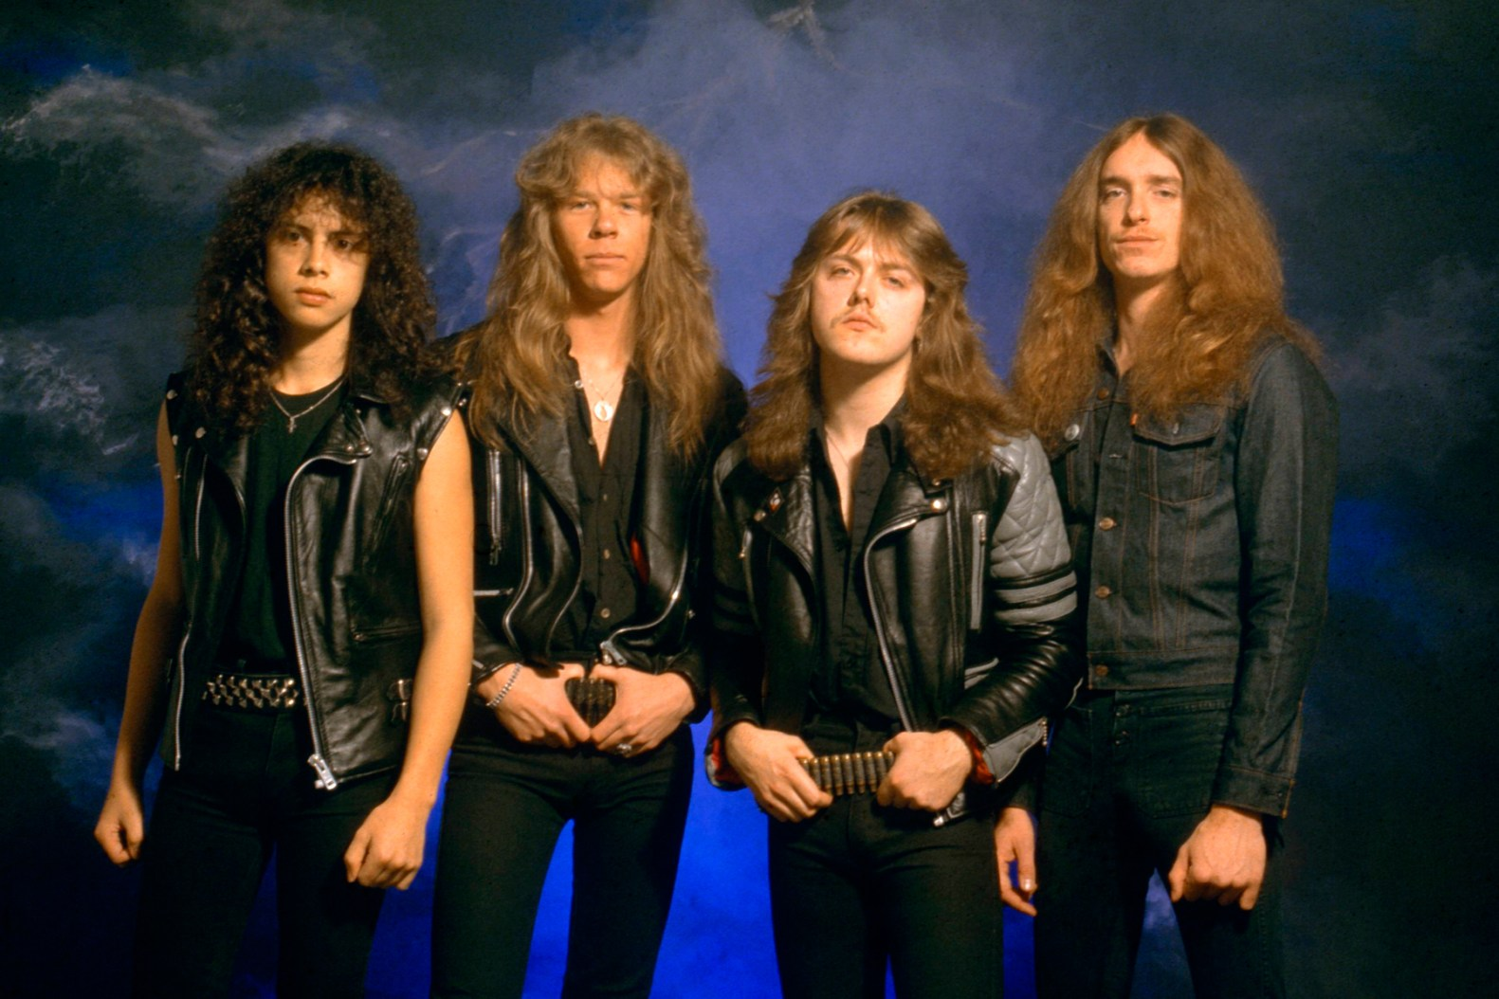
METALLICA
Formed in 1981 in Los Angeles, Metallica are one of the most famous heavy metal bands and still tour today. They are one of the most commercially successful bands of all time.
They sold more than 125 million records worldwide
They were influenced by Black Sabbath, Deep Purple, Kiss, Led Zeppelin, Queen, Ted Nugent, AC/DC, Rush, Aerosmith, and Judas Priest.
James Hetfield (Guitar)
Lars Ulrich (Drums)
Kirk Hammet (Lead Guitar)
Robert Trujillo (Bass)

Slide 14
Component 1
3. Heavy Metal
1x Background/History
1-2x Subgenres and key bands
1x Characteristics including details on power chords, pedals and downtuning
1x Instruments
1x Black Sabbath
1x Metallica
What slides does my coursework need to have?

