Slide 1
Samba
Style 4

Slide 2
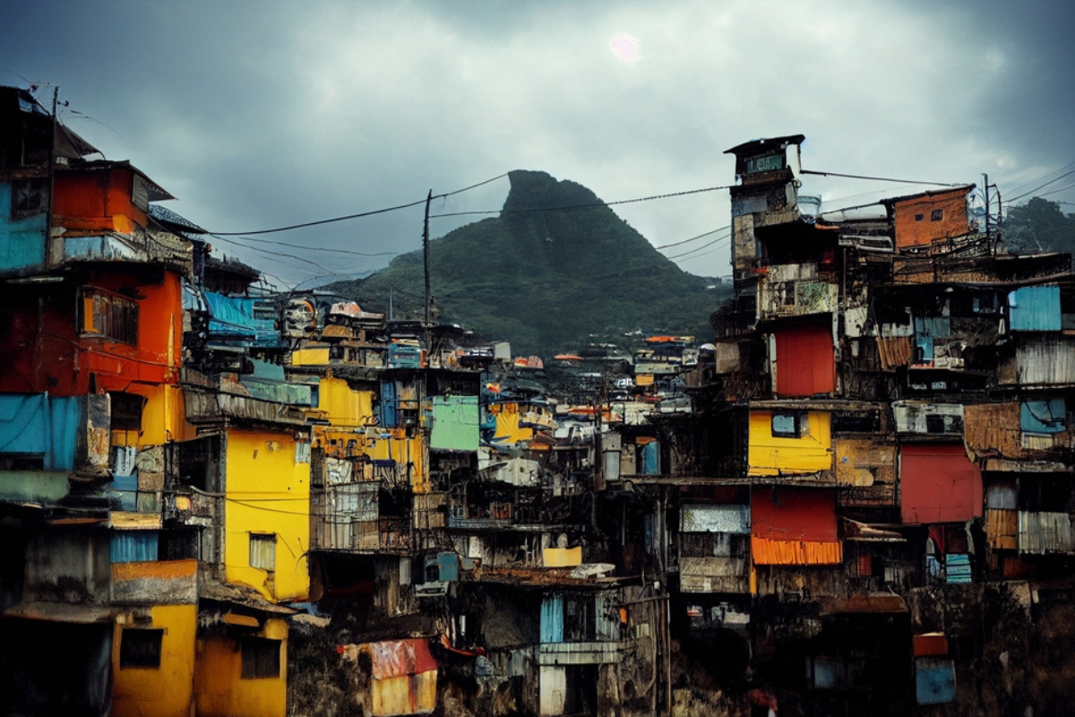
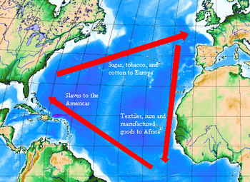
Background
Links to the transatlantic slave trade (African slaves taken to Brazil).
African rhythms and music that eventually developed into Samba.
Samba developed in the 1950s in favelas (Brazilian slums
Samba is the music that has a strong association to Carnival in Rio de Janeiro. The Carnival has been held every year since 1723 and lasts up to six days with over two million people lining the streets to watch. Local communities each have a float to decorate and are accompanied by their local samba school.

Slide 3
Rhythm and Tempo
Uses Son Clave rhythms which is a Cuban rhythm, sometimes described as a 3 - 2 rhythm owing to the three augmented strikes, then two faster strikes.
Son clave is an important rhythm in samba music. It is a rhythm that is syncopated (oof the beat) in the first bar and is played on the second and third beat in the second bar.
Cross-rhythms are an effect created when two or more conflicting rhythms are heard at the same time. Eg one may be in simple time and another in triple time.
Uses 4/4 or 2/4 time signature
Samba is energetic and fast in tempo (Presto, Vivace, Allegro)

Slide 4
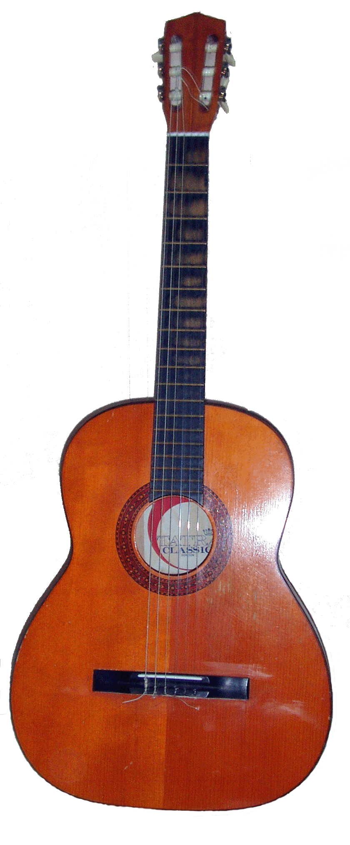
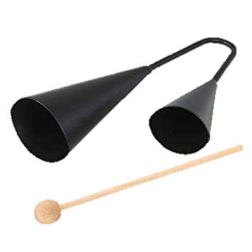
Melody/ Pitch
Samba is mostly rhythmic at its heart but there are melody instruments used.
Vocals, Guitar and Brass instruments are commonly used to play melodies.
The agogo bell features a high and a low pitch.
A range of drums are used in a ensemble, which create a range of sounds and pitches.

Slide 5
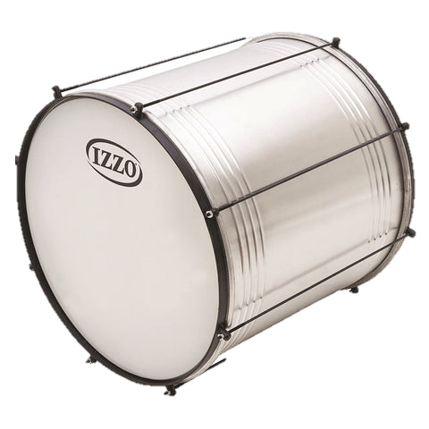
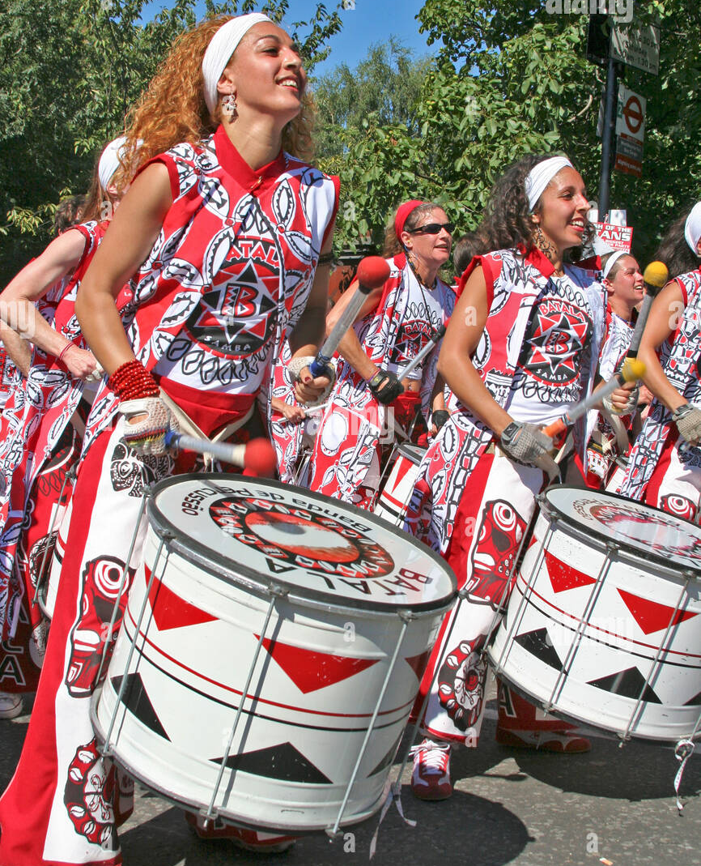
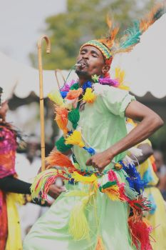
Structure
There is no set written structure as an ensemble is often led by a band leader who signals when to change sections.
Phrases are performed with call and response (the band copy the rhythms played by the leader).
The signals are often played on a whistle called the apito by the leader on the repinique.
There will be a main section of ostinato layered on top of each other, which returns throughout a piece. This is known as the groove. The music might include solo sections, call and response and sections played in unison.

Slide 6
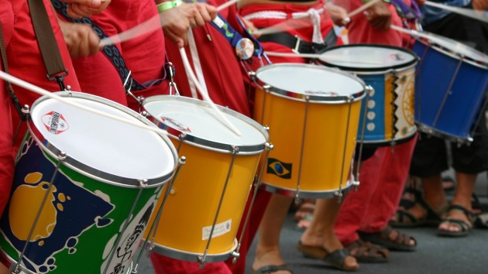
Texture & Dynamics
There are a few different textures in Samba music depending on the section being played.
Polyrhythmic texture is when all parts are playing different rhythms layered on top of each other.
Monophonic texture is when the repinque plays a solo or the call section of call and response.
Samba music is very loud as it needs to be heard outside by thousands of people. The dynamic changes are signalled by the leader using the apito.

Slide 7
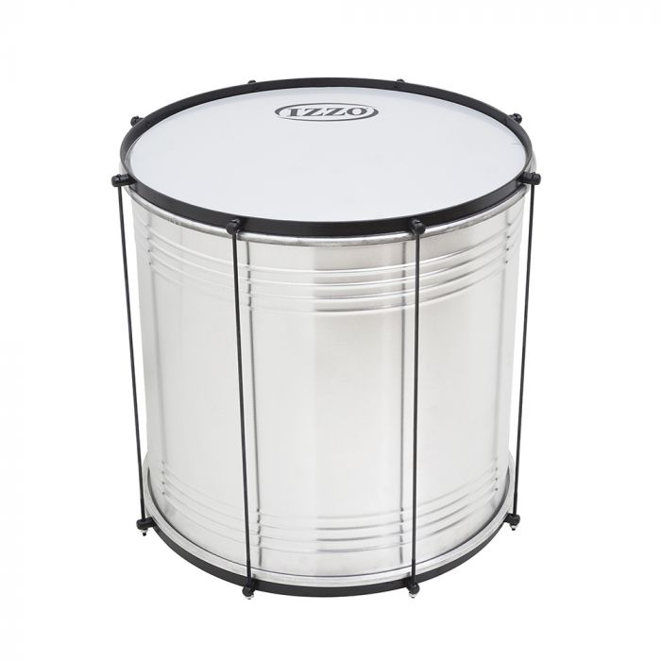
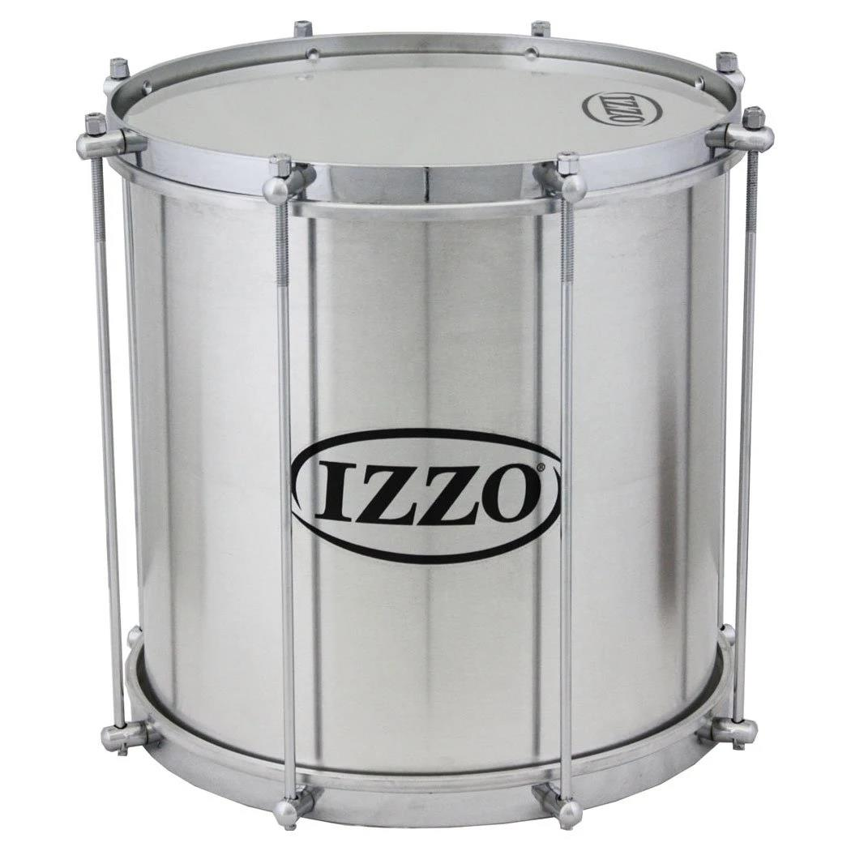
Instrumentation
Surdo
Repinique
The Surdo is the largest and deepest pitched drum in the Samba band. Large mallets are used to play it and it usually plays the beat to keep the group in time. Surdo sizes normally vary between 40 cm and 65 cm in diameter. Surdo skins can be made of goat skin or plastic and the shells are made from either wood, galvanised steel or aluminium.
The repinique is similar to the surdo but much smaller. Wooden sticks or one wooden stick and a hand are used to play it. It usually plays a variation on a standard 1-2-3-4 beat to help keep the group in time. Repinique drums are smaller in diameter with a skin made of nylon or goat skin and the shell made of wood or metal.

Slide 8
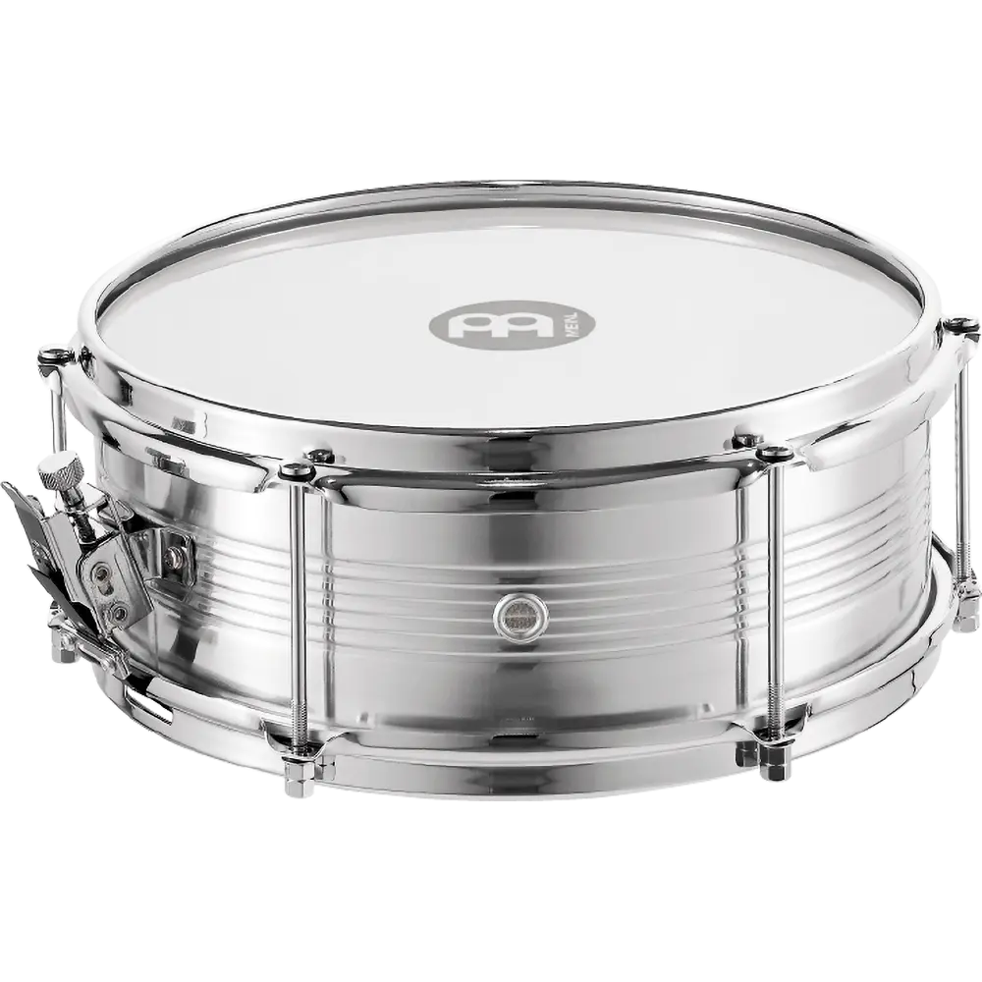
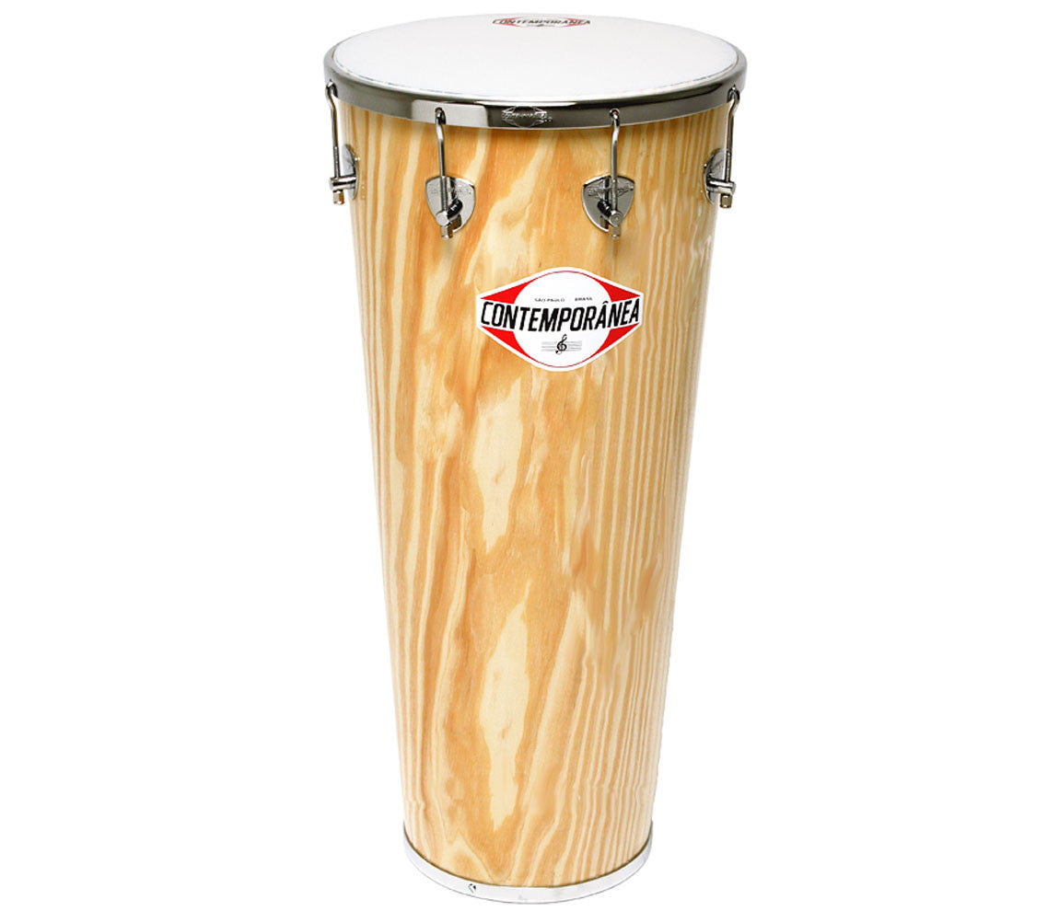
Instrumentation
Caixa
Timbal
The Caixa is a smaller drum in a Samba band, it is the Brazilian snare drum. It has curled wires attached to the bottom head to produce the sharp ‘snare’ sound. Wooden drumsticks are used to play it. The Caixa is usually 30 or 36 cm in diameter and 20 cm. Made originally from goat skin, gut wires and wood, it is now usually made from mylar plastic and metal with metal wires.
The Timbal is a long conical drum which is played with both hands. The timbal is made to play loud, fast phrases and solos with powerful slaps. The Timbal can come in many lengths, the longer they are, the deeper the bass sound. They are usually made of lacquered wood or metal for the shell with a tuneable nylon head.

Slide 9
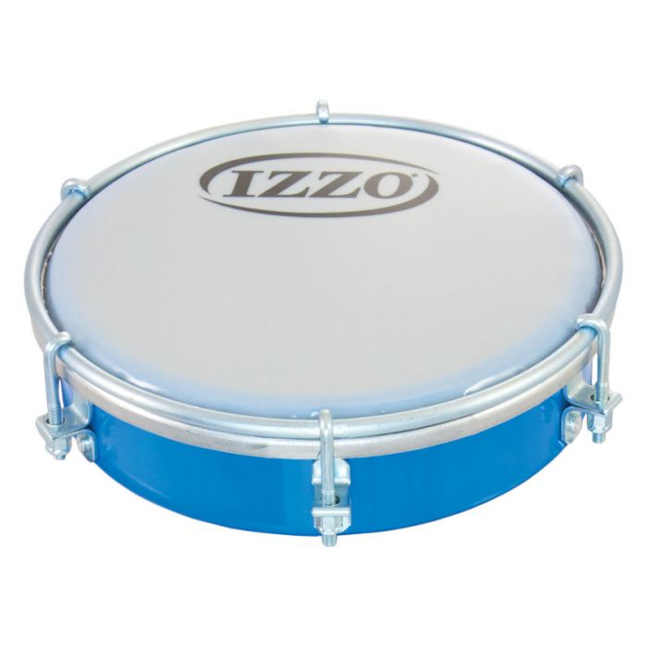
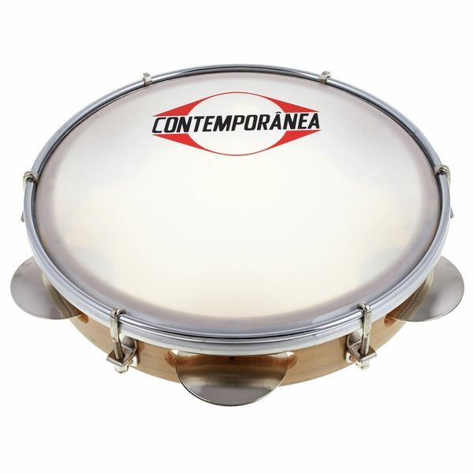
Instrumentation
Tambourim
Pandeiro
The Tambourim is a small hand-held drum that is high in pitch and is played with a pronged plastic beater. It has only one head and is held with the weaker hand to allow the dominant hand to play the rhythms. The Tambourim is about 30cm in diameter and 7cm deep. It is made from metal, wood or plastic with a tuneable nylon head, similar to the Timbal. You can use your fingers to change the tension and sound from the underside of the drum. A common playing technique called virado is often used. To do this, you flip the drum upside-down in the middle of the rhythm, which produces one note that is slightly delayed.
The Pandeiro is essentially the Brazilian version of a tambourine. It is a handheld drum with a row of jingles around the edge, it also has a tuneable head similarly to the Tambourim. Usually, Pandeiro rhythms are played by changing between the thumb, fingertips, heel, and palm of the hand. The difference between the tambourine and pandeiro is the way the jingles (platinelas) are placed. On a Pandeiro, the platinelas are cupped which gives a more muted tone.

Slide 10
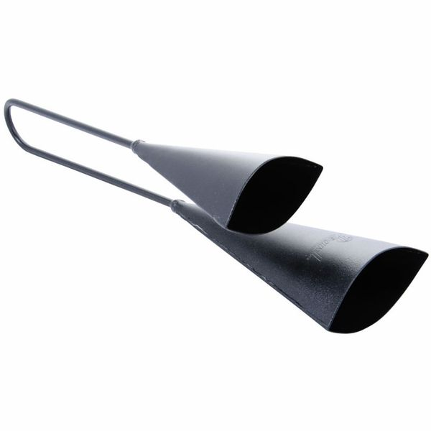
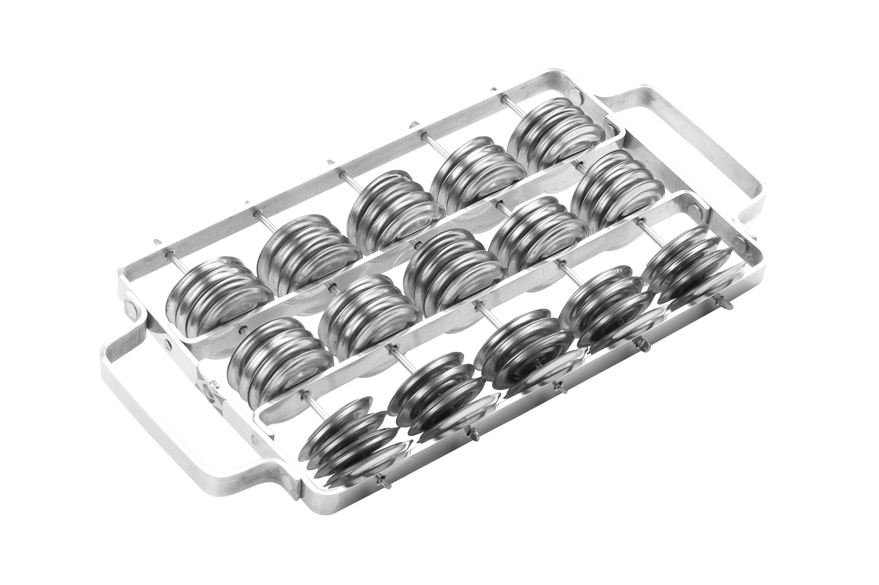
Instrumentation
Chocolho
Agogô
Agogô is the Portuguese word for ‘bell’. This instrument is two metal cones that you hit with a wooden stick. One of the bells is larger than the other and therefore makes a deeper sound. There are many rhythm patterns played on the agogo, but the most common one used in Samba is a syncopated pattern like the one below:
Chocolho means ‘shaker’ in Portuguese. It is a metal frame with several rows of jingles (platinelas). It is held with two hands and shaken up and down. This movement is known as ‘Rocar’. They are used to support the sound of the Caixa and sustain the rhythm. The frame can be made of either wood or metal and the platinelas are made from metal. This instrument is classed as an idiophone, as it produces sound through vibration of the instrument itself.

Slide 11
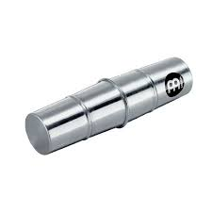
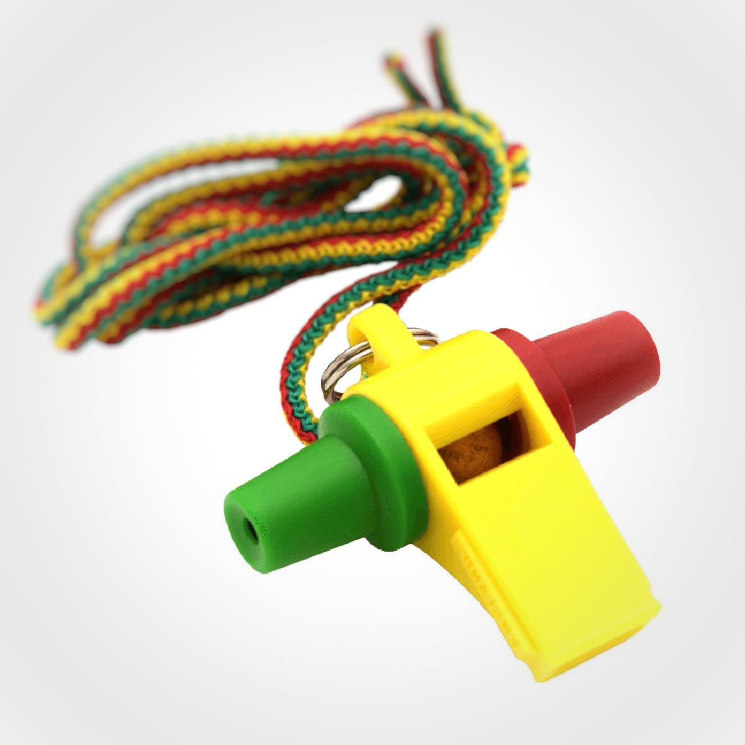
Instrumentation
Ganzá
Apito
The Ganzá is a cylindrical metal shaker that is filled with beads. They are usually used to play a basic rhythm under the rest of the group. Some ganzás are made from hand woven basket and others are metal, the metal ones are much louder. This instrument is classed as an indirectly struck idiophone, as sound is produced from the vibration of the beads on the casing.
Apito is the Portuguese word for ‘whistle’. It is a loud three toned whistle that is played by the band leader. The apito is used to guide the performance and let players know when and what sections of the music to play. You can change the tone of the whistle by covering one or both of the side holes. In addition to directing the group, the apito plays rhythms of its own, the high pitch tone can cut through the noise of the other instruments.

Slide 12
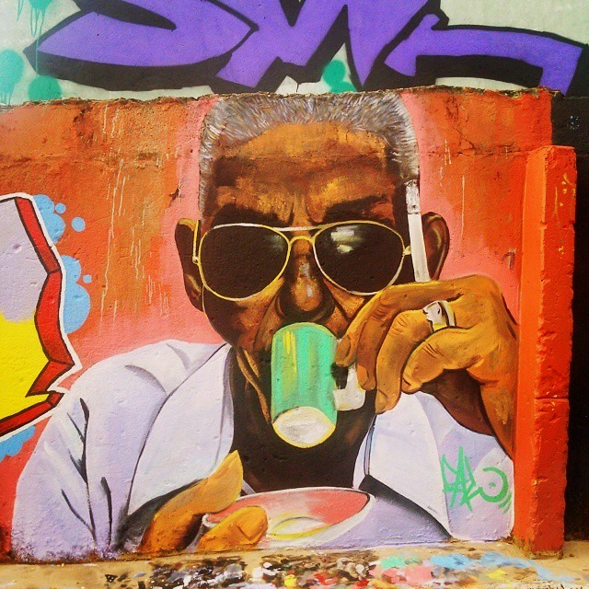
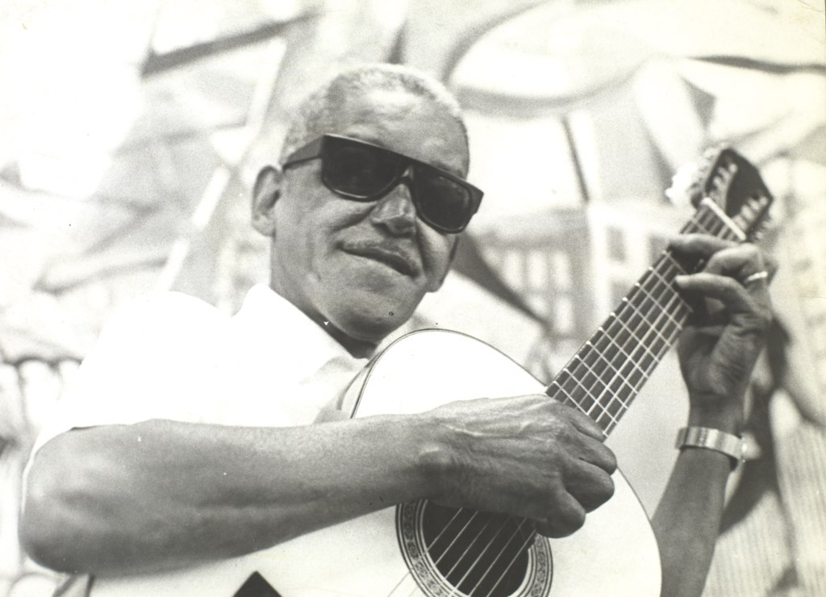
Iconic Artist: Cartola
Angenor de Oliveira, known as Cartola was born in 1908 and died in 1980. He was a Brazilian singer, composer and poet considered to be a major figure in the development of samba.
Cartola composed melodies, harmonies, and lyrics. His lyrics are notable for their very correct use of Portuguese, especially considering his lack of formal higher education. His poetry binds in an effective manner elegance and emotion, while keeping a relatively low level of complexity, which made his work accessible to larger layers of the population.

Slide 13
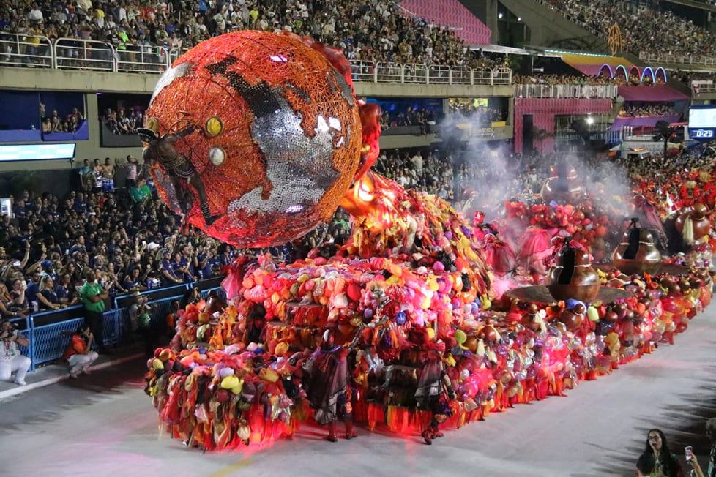
Samba School: Acadêmicos do Grande Rio
Grande Rio won in 2022 with the samba-plot Fala, Majeté! Sete Chaves de Exu, composed by Gustavo Clarão, Arlindinho Cruz, Igor Leal, Claúdio Mattos, Jr. Fragga and Thiago Meiners.
The Grêmio Recreativo Escola de Samba Acadêmicos do Grande Rio is a samba school of the Special Group of the carnival of the city of Rio de Janeiro, being headquartered on Almirante Barroso street in Duque de Caxias.
They have won several titles and prizes in Rio Carnival including:
Grupo Especial (First division of Rio Carnival): 2022
Estandarte de Ouro (best plot - Grupo Especial): 2022
Grupo de Acesso A (second division): 1992
Estandarte de Ouro (best plot): 1994
Estandarte de Ouro (best samba/Grupo de Acesso): 1992
Best place in the Special Group: 2006 and 2007 (2 vice-championships)

