Slide 1
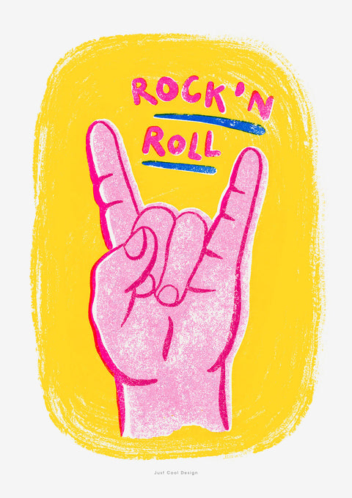
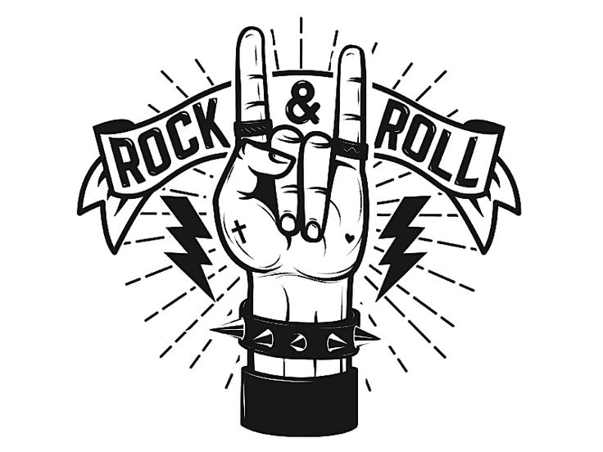
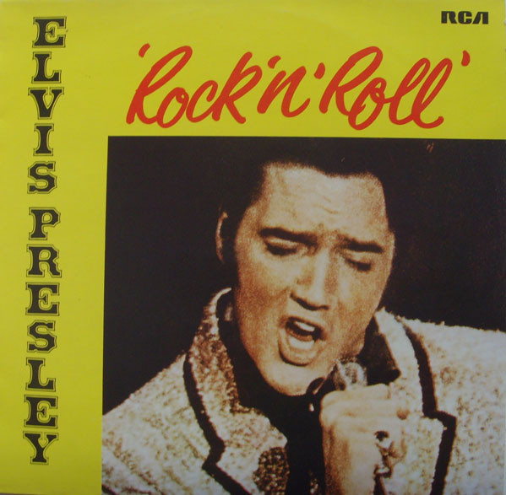

Slide 2
History
A style of popular music that originated in the USA in the 1950s.
When it began in 1954, Rock and Roll was a total shock. It was an explosion of power, a total outrage to society.
American and the western world was in a hopeful mood following WW2 and for the first time ‘teenagers’ (this word was invented in the 50s) had their own money to spend. They began searching for their own ‘thing’ and Rock n Roll was it.
Rock n Roll brought together many different threads of popular music and rose to its greatest popularity in 1955-56 with artists like Bill Haley and Elvis Presley.

Slide 3
Influences
Boogie-Woogie
Jazz
Rock n Roll
Blues
Gospel
Country

Slide 4
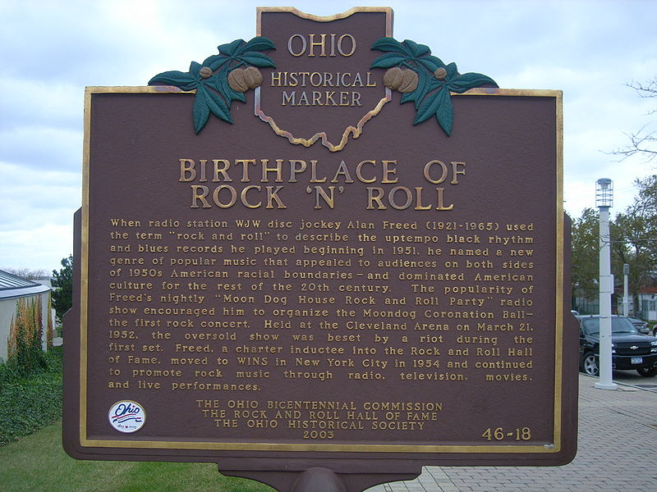

Slide 5
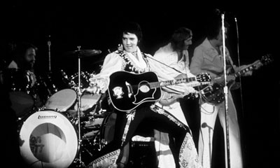
Rock n Roll Instruments
Vocals
Lead Guitar
Rhythm Guitar
Bass Guitar or Double Bass
Drum Kit
Keyboard
Sometimes used
Trumpet/Trombone/Saxophone

Slide 6
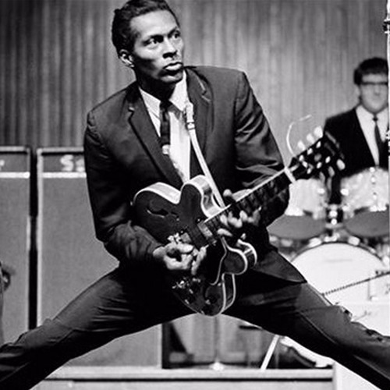
Melody
Improvisation: Making stuff up on the spot. Different every time – this comes from Blues and Jazz.
The main difference is that rock n roll improvisation uses the notes of the key you are in, instead of just any notes or the blues scale.

Slide 7
Melody
Close harmony: Vocals use close harmony, where they sing in harmony but the notes are close e.g. in thirds.

Slide 8
Melody
Walking Bass Line: Played by the Bass instrument such as Double Bass or Bass Guitar. A walking bass is one where the notes walk up and down the stave.

Slide 9
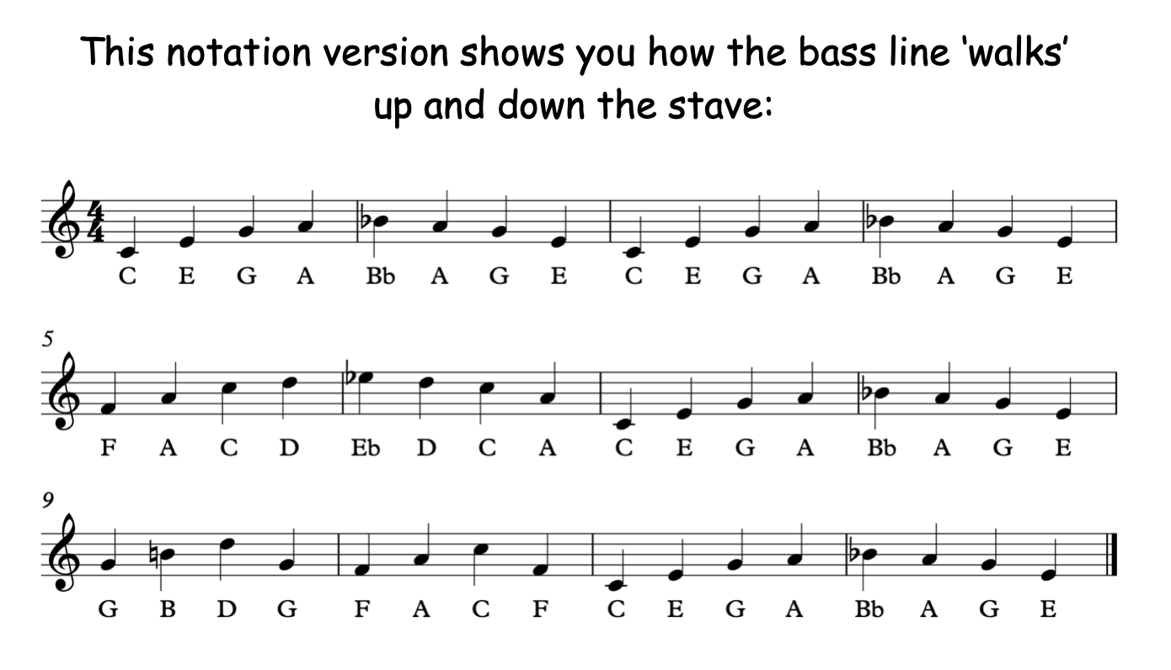
Walking Bass Line

Slide 10
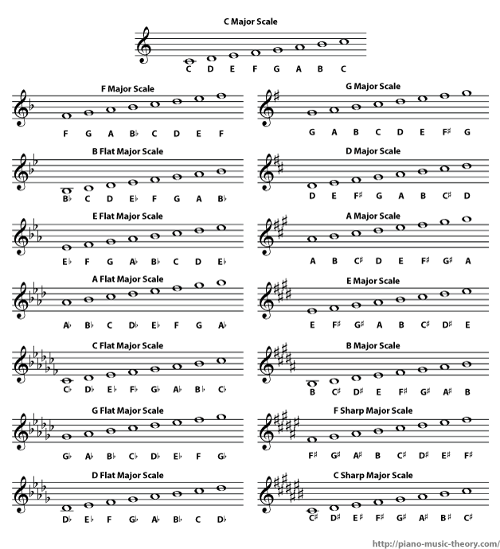
Tonality & Harmony
Major Keys: Most rock n roll songs were in Major keys as they were meant to be upbeat, joyful and for dancing!
Close harmony: Vocals use close harmony, where they sing in harmony but the notes are close e.g. in thirds.

Slide 11
12 Bar Blues
Every Blues song uses the same progression of chords (a specific order in which the chords are played).
This progression is called the ’12 bar blues’ and is (you guessed it!) 12 bars long.
12 Bar Blues uses chords I, IV, V.
I | I | I | I
IV | IV | I | I
V | IV | I | I

Slide 12
12 Bar Blues
This musical feature is taken from Blues.
There are seven chords in every key.
Chords are sets of notes played at the same time!
This can be in any key but this example is in C Major
CEG | CEG | CEG | CEG
FAC | FAC | CEG | CEG
GBD | FAC | CEG | CEG

Slide 13
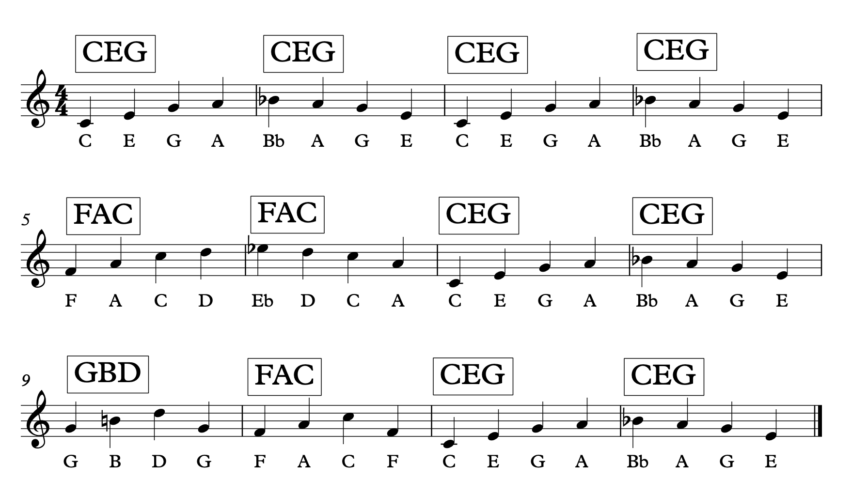
Notes:
Pupils clap, click or stamp in time to the music (try ‘Jonny be Goode’, ‘Hound Dog’ then ‘All Blues’) to highlight the change in chords

Slide 14
Song form: Rock n roll songs are in song form, which is also called verse-chorus form. It is the structure most popular songs use.
Structure

Slide 15
Structure
Instrumentals
Solo verses
Coda/Outro

Slide 16
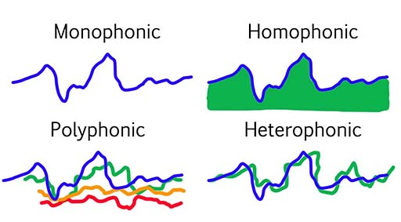
Homophonic (Melody & Accompaniment) Texture – a solo singer accompanied by instruments. Some textural variety within songs e.g. instruments ‘dropping out’
Texture

Slide 17
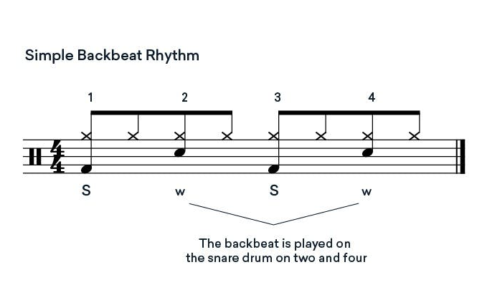
Rhythm & Tempo
Rock n Roll music tended to be in 4/4 time signature. It usually had a lively (Vivace) tempo suitable for dancing.
Rock n Roll uses backbeat rhythms: A backbeat in music is a steady beat that emphasizes the second and fourth beats in 4/4 time.

Slide 18
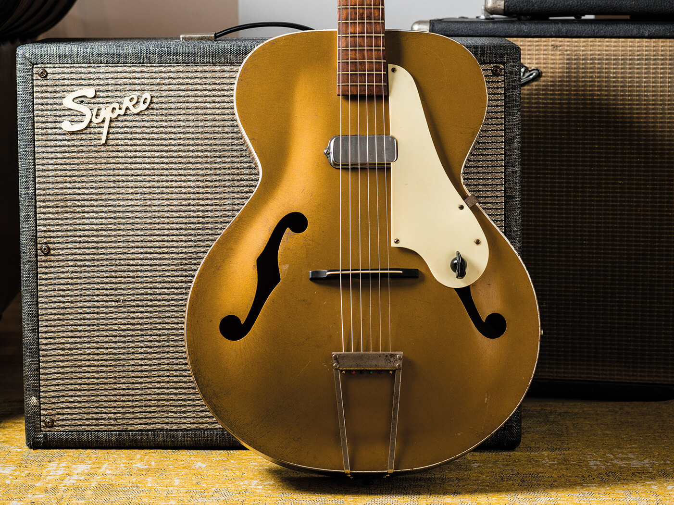
Amplification: The first speaker amplifiers were being used in rock n roll to boost the sound of the guitars.
Technology
The first electric guitar was made in 1937
Distortion: In the early 1950s, guitar distortion sounds started to evolve based on sounds created earlier in the decade by accidental damage to amps. Before distortion pedals and software were created, they made alterations to their amps to create the sound. E.g. increasing the gain or dislodged vacuum tubes.
Microphones: Mics have been around since the late 1800s, but ribbon mics were commonly used in rock n roll. Ribbon mics use thin aluminium ribbon to create electromagnetic induction.

Slide 19
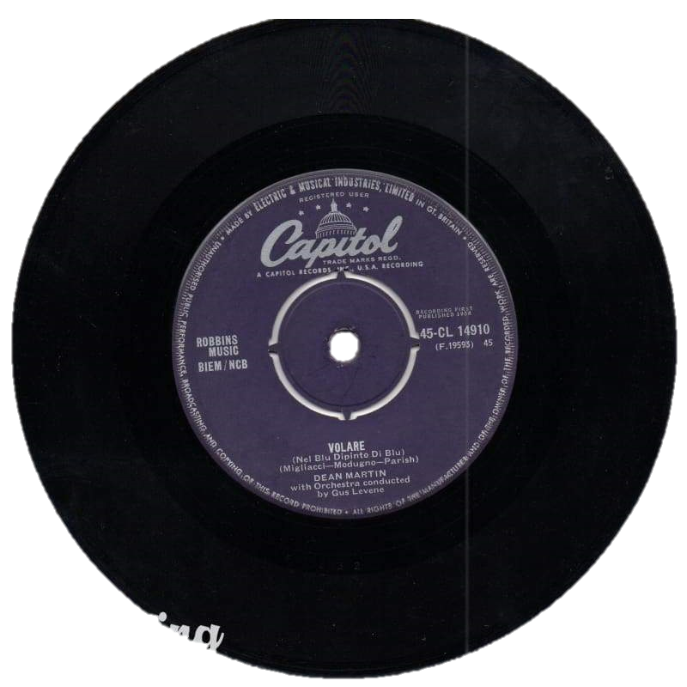
There were many technological developments during this era.
Audiences could listen to rock 'n' roll music on the radio and increasingly watch them on television.
Mass production of 45 rpm vinyl records, or singles, meant that music could be bought cheaply and easily.
The introduction of the electric guitar was a key development in the sound of rock 'n' roll.
Technology

Slide 20
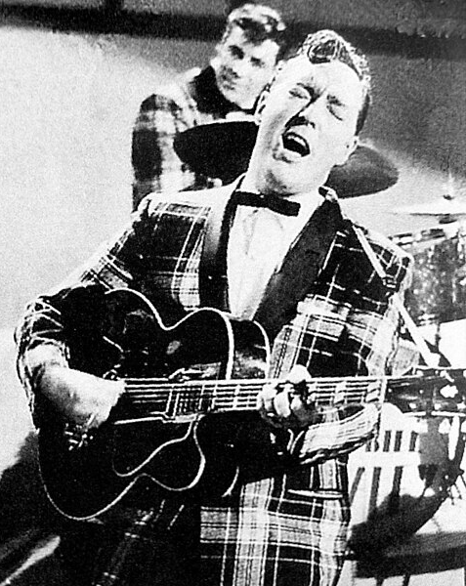
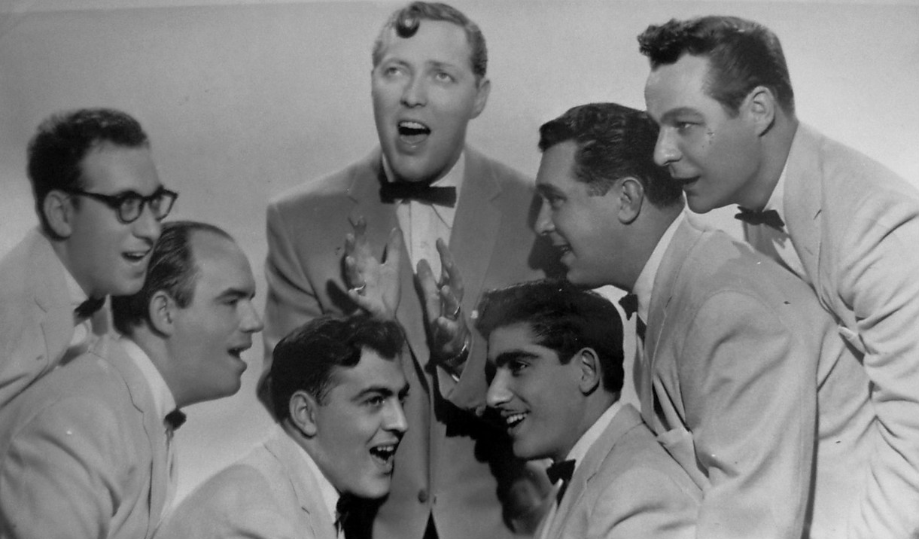
William Haley was an American Rock n Roll artist. He is credited with making the genre popular to the masses. His band was called Bill Haley & His Comets. They have sold over 60 million records worldwide.
Some of his famous songs include ‘Rock Around the Clock’, ‘Shake, Rattle and Roll’ and ‘See You Later, Alligator’.
Bill Haley

Slide 21
Bill Haley & His Comets

Slide 22
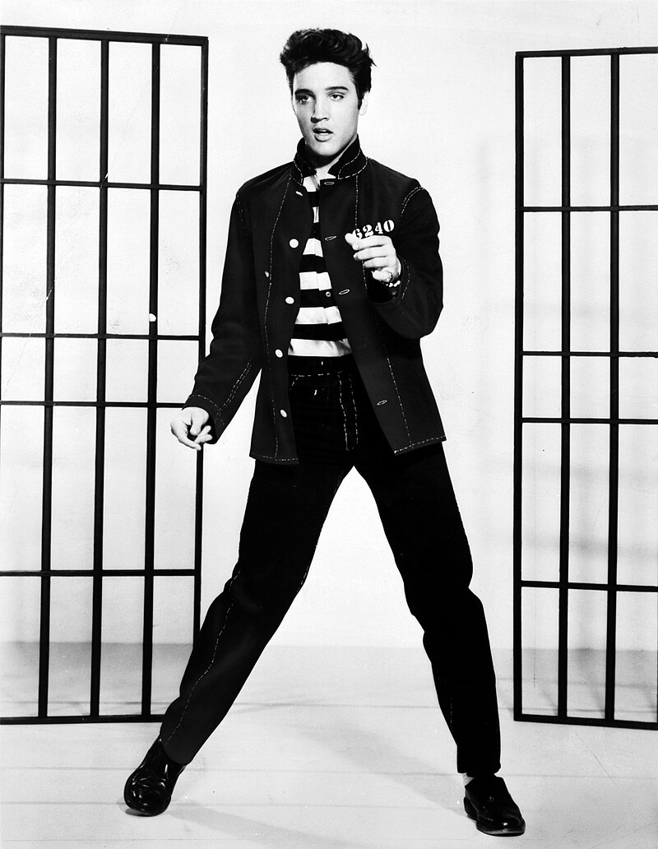
Elvis Presley was an American singer and actor. He is regarded as one of the most famous music artists of all time and known as the ‘King of Rock n Roll’.
His music was energetic, sexually provocative and a transformative influence on race relations in America.
Presley would play guitar and sing with his band.
He has sold over 500 million records worldwide and is one of the best selling artists of all time.
He won three Grammy Awards, as well as, the Grammy Lifetime Achievement Award at only 36 years old.
Elvis Presley

Slide 23
Elvis Presley

Slide 24
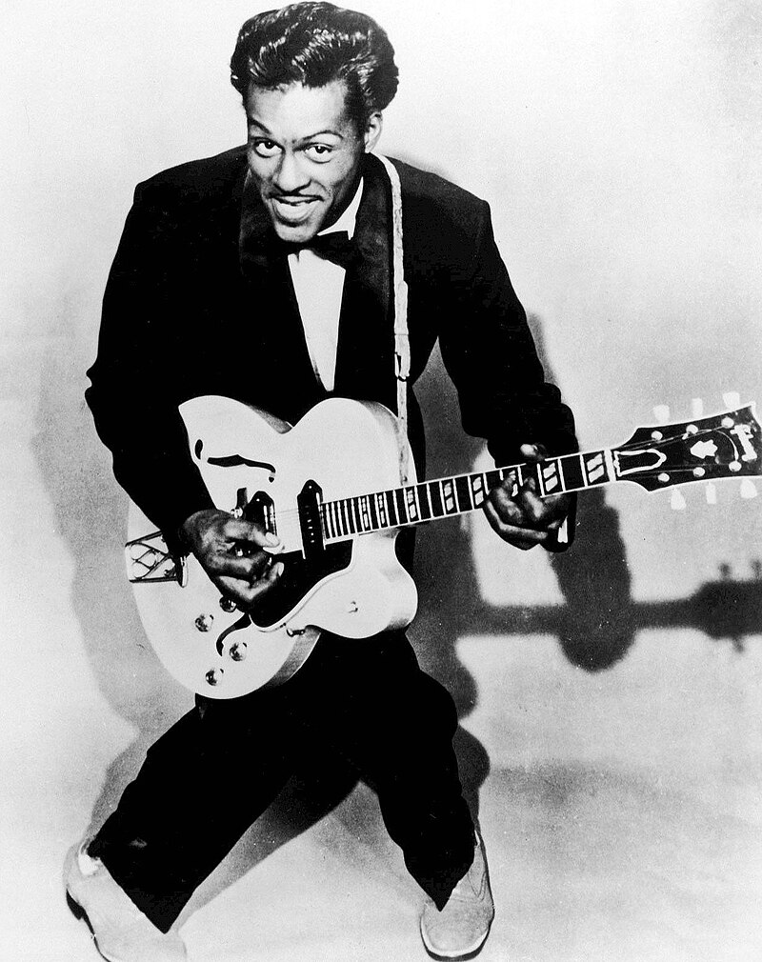
Charles Berry was an American singer, guitarist and songwriter who pioneered the rock n roll genre. He was nicknamed the ‘Father of Rock n Roll’.
He was known for his guitar solos and showmanship on stage and was a major influence on the Rock genre that came later.
His songs were themed around consumerism and teen life.
Some of his most famous songs include ‘Roll over Beethoven’, ‘Maybellene’ and ‘Jonny B. Goode’.
Chuck Berry

Slide 25
Chuck Berry

